Slide 1

Experiences in Using a MOOC to Support Teacher Professional Development of a New AP Course in Computer Science
26th SITE 2015 Conference
Las Vegas, March 2-6, 2015
Dr. Jeff Gray
Dr. Mokter Hossain
Department of Computer Science
University of Alabama
Tuscaloosa-35401

Slide 2

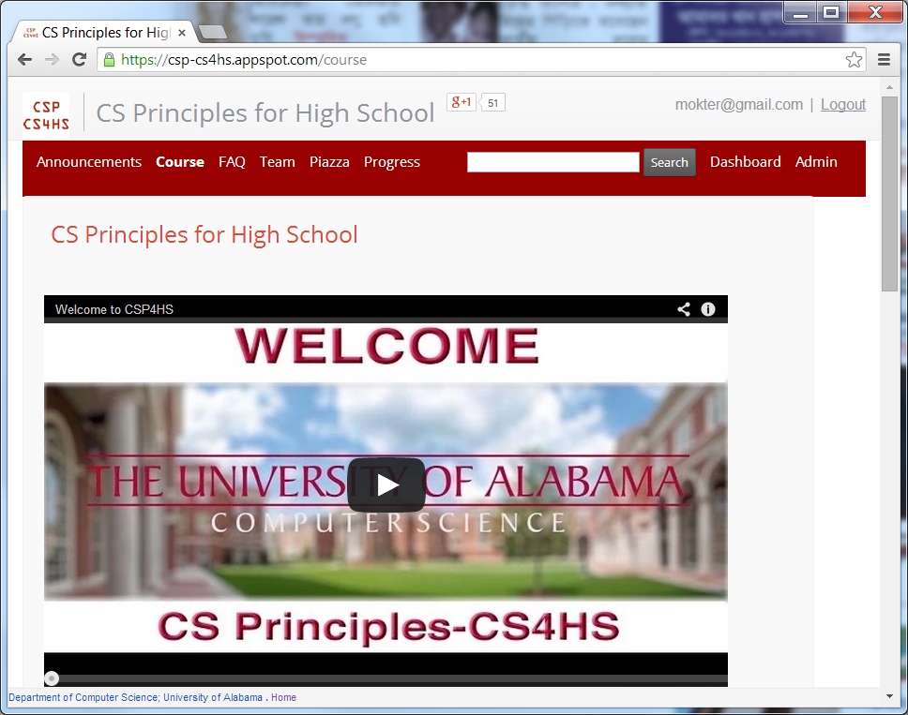
Experiences in Using a MOOC to Support Teacher Professional Development of a New AP Course in Computer Science
MOOC- Massive Open Online Course
https://csp-cs4hs.appspot.com

Slide 3
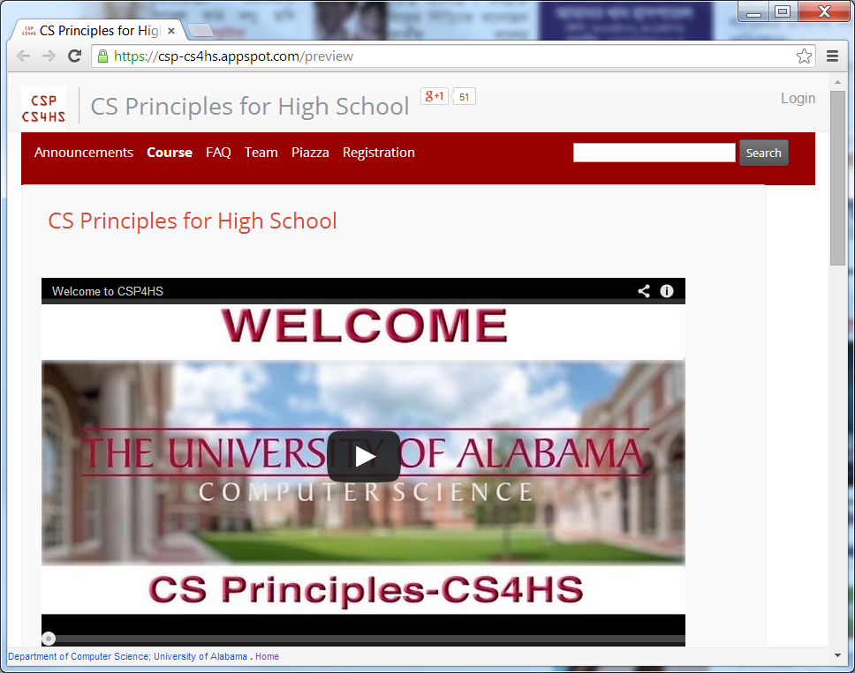
Experiences in Using a MOOC to Support Teacher Professional Development of a New AP Course in Computer Science
Preview Mode
https://csp-cs4hs.appspot.com/preview

Slide 4
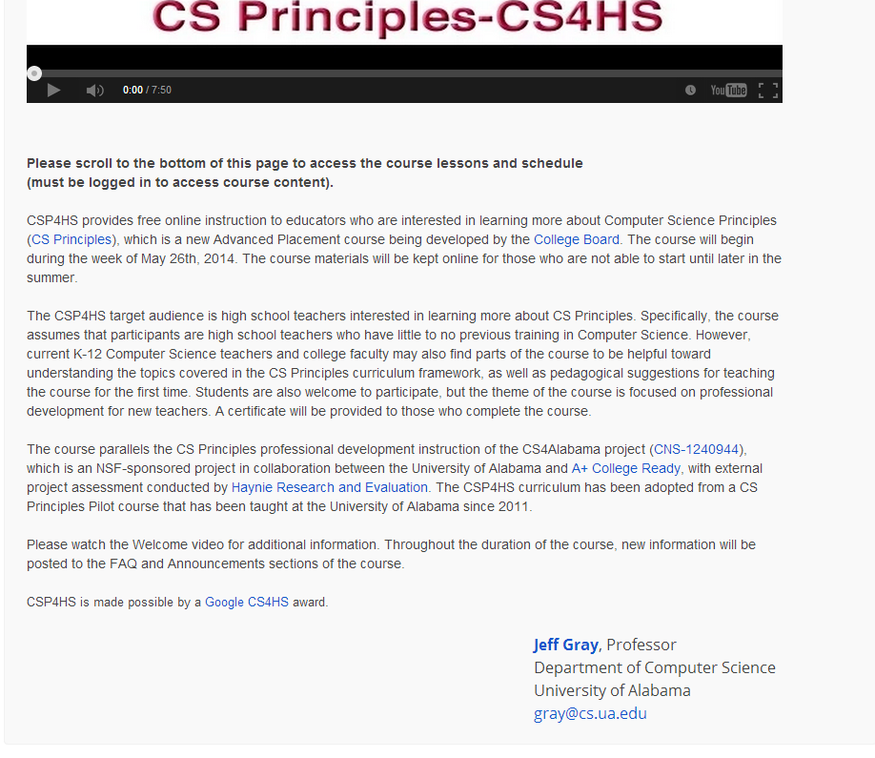
Experiences in Using a MOOC to Support Teacher Professional Development of a New AP Course in Computer Science
Middle of the Home Page
https://csp-cs4hs.appspot.com

Slide 5
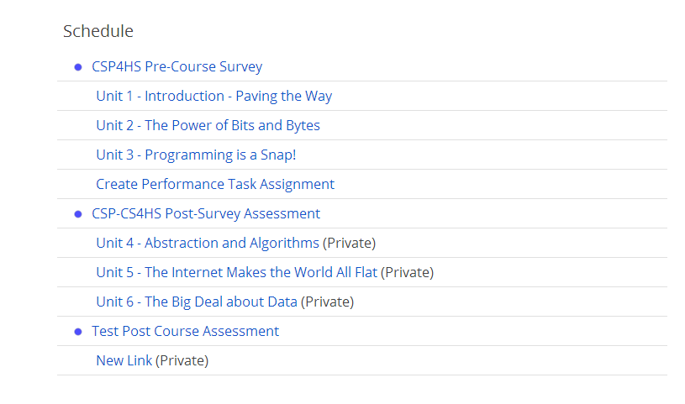
Experiences in Using a MOOC to Support Teacher Professional Development of a New AP Course in Computer Science
Bottom of the Home Page
https://csp-cs4hs.appspot.com

Slide 6
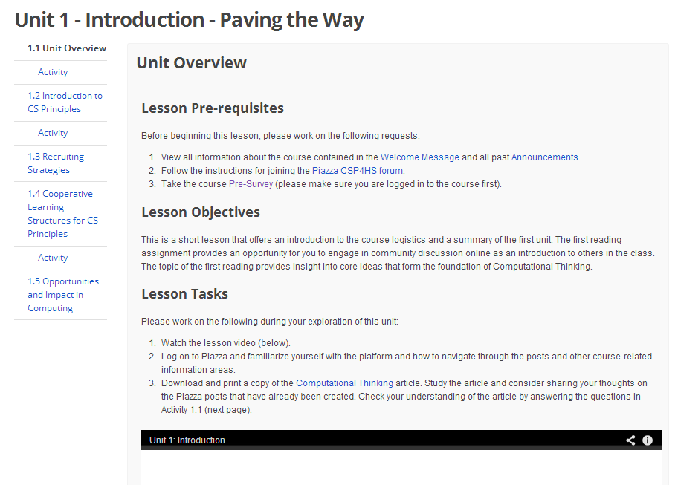
Experiences in Using a MOOC to Support Teacher Professional Development of a New AP Course in Computer Science
View of an Unit
https://csp-cs4hs.appspot.com/unit?unit=21&lesson=23

Slide 7
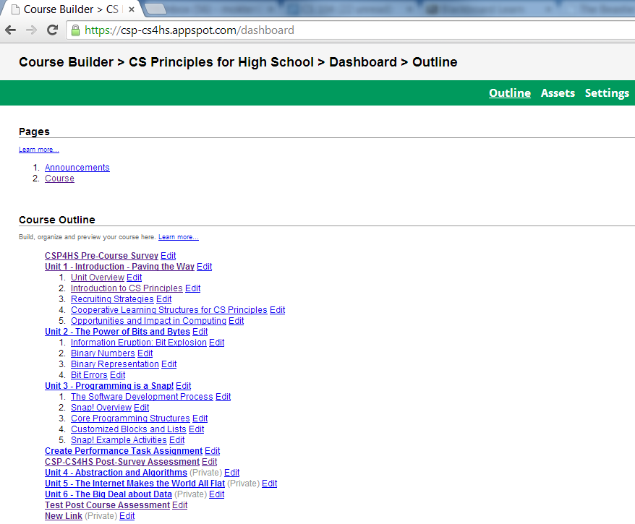
Experiences in Using a MOOC to Support Teacher Professional Development of a New AP Course in Computer Science
Course Outline

Slide 8
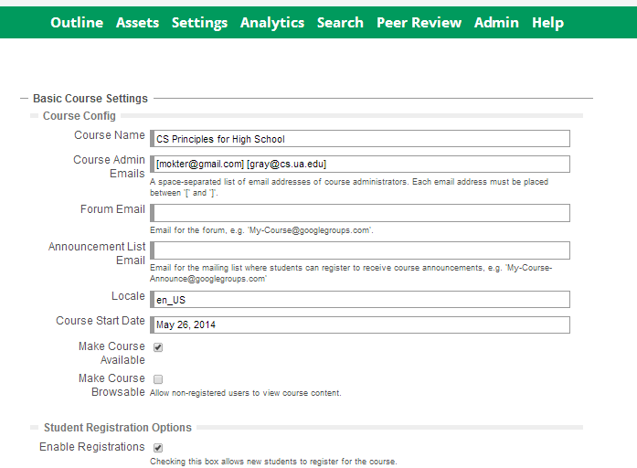
Experiences in Using a MOOC to Support Teacher Professional Development of a New AP Course in Computer Science
Settings

Slide 9
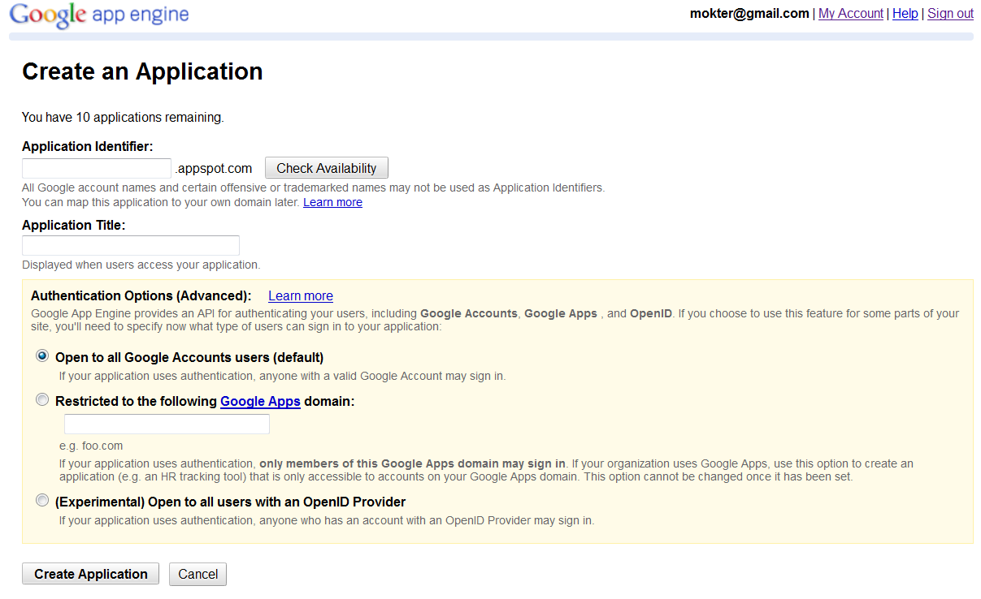
Experiences in Using a MOOC to Support Teacher Professional Development of a New AP Course in Computer Science
Steps of Implementation
Step-1: Create an Application on GAE at: https://appengine.google.com/start/createapp

Slide 10
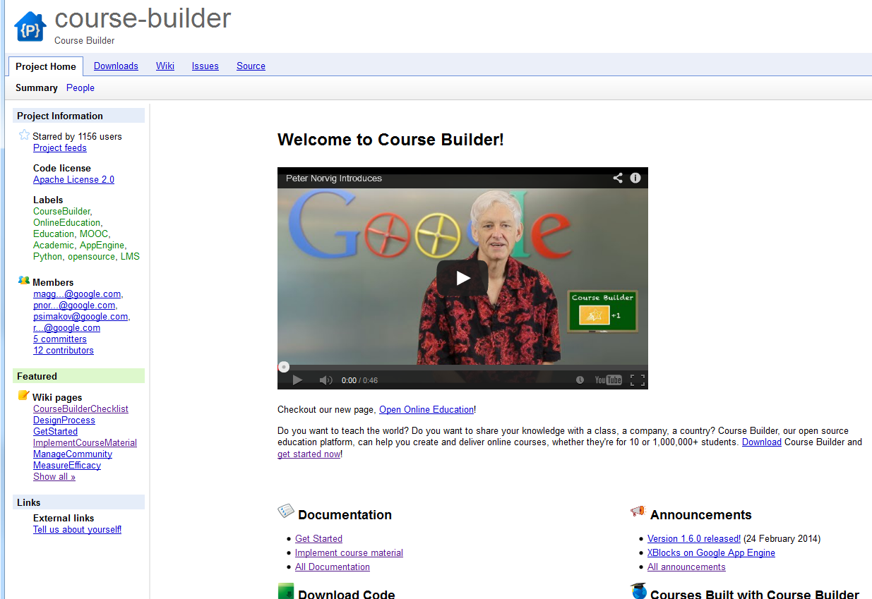
Experiences in Using a MOOC to Support Teacher Professional Development of a New AP Course in Computer Science
Steps of Implementation
Step-2: Go to the Google Course Builder Home page at: https://code.google.com/p/course-builder/

Slide 11
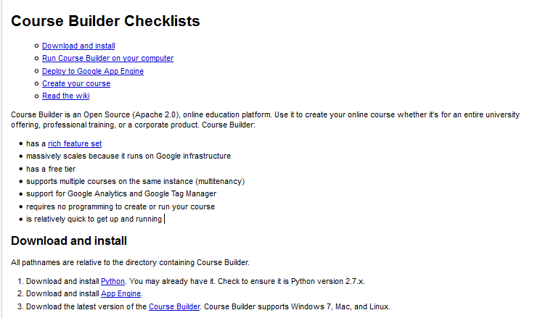
Experiences in Using a MOOC to Support Teacher Professional Development of a New AP Course in Computer Science
Steps of Implementation
Step-3: Click on the Get Started Link (Located under Documentation and follow the steps:

Slide 12
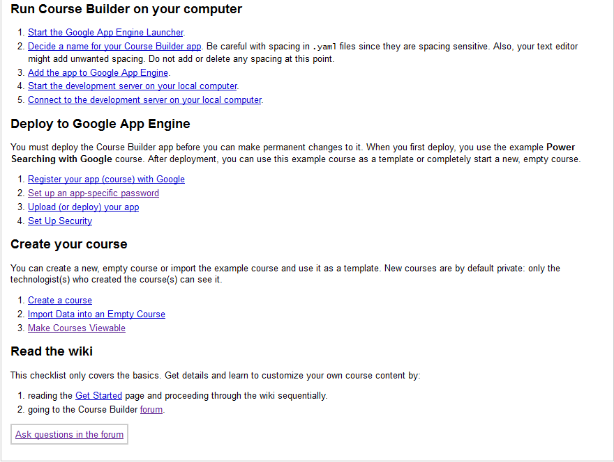
Experiences in Using a MOOC to Support Teacher Professional Development of a New AP Course in Computer Science
Steps of Implementation
Step-4: Click on the Get Started Link (Located under Documentation and follow the steps:

Slide 13
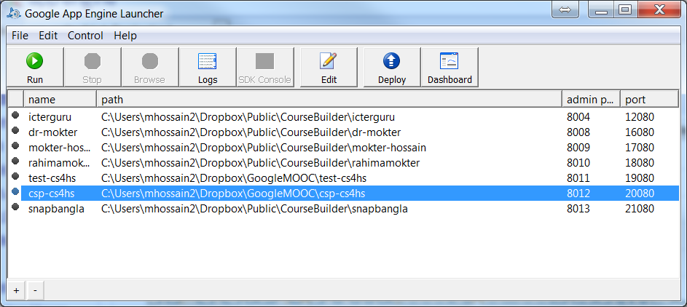
Implementation of a MOOC with Google Course Builder and App Engine
Deployment with Google App Engine Launcher

Slide 14
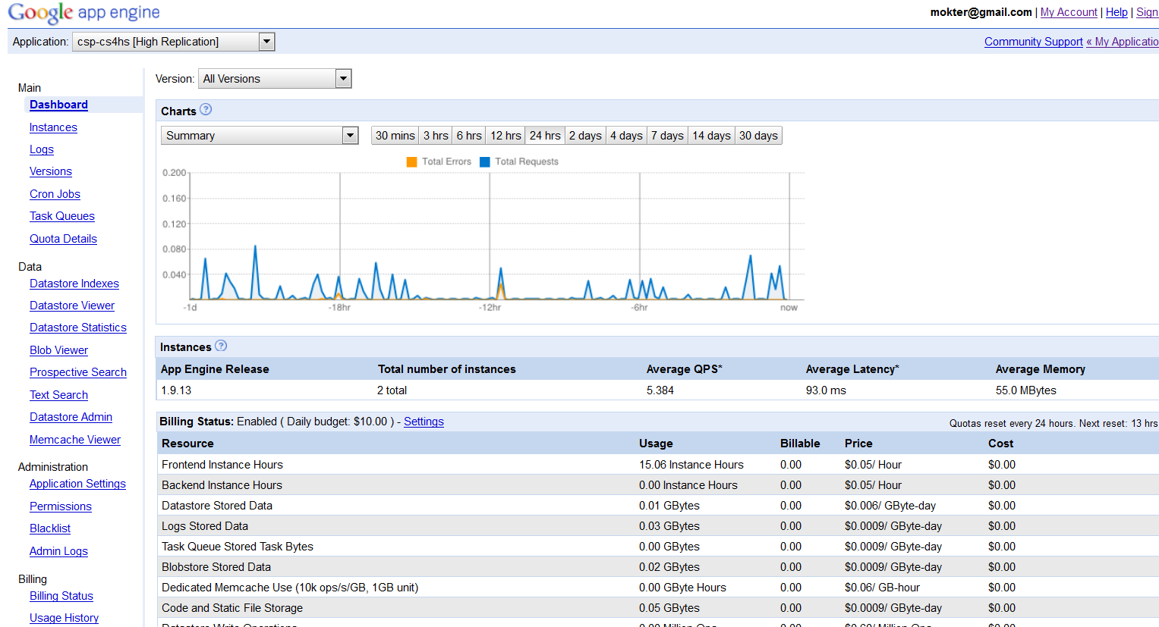
Implementation of a MOOC with Google Course Builder and App Engine
Google App Engine Dashboard
https://appengine.google.com/dashboard

Slide 15
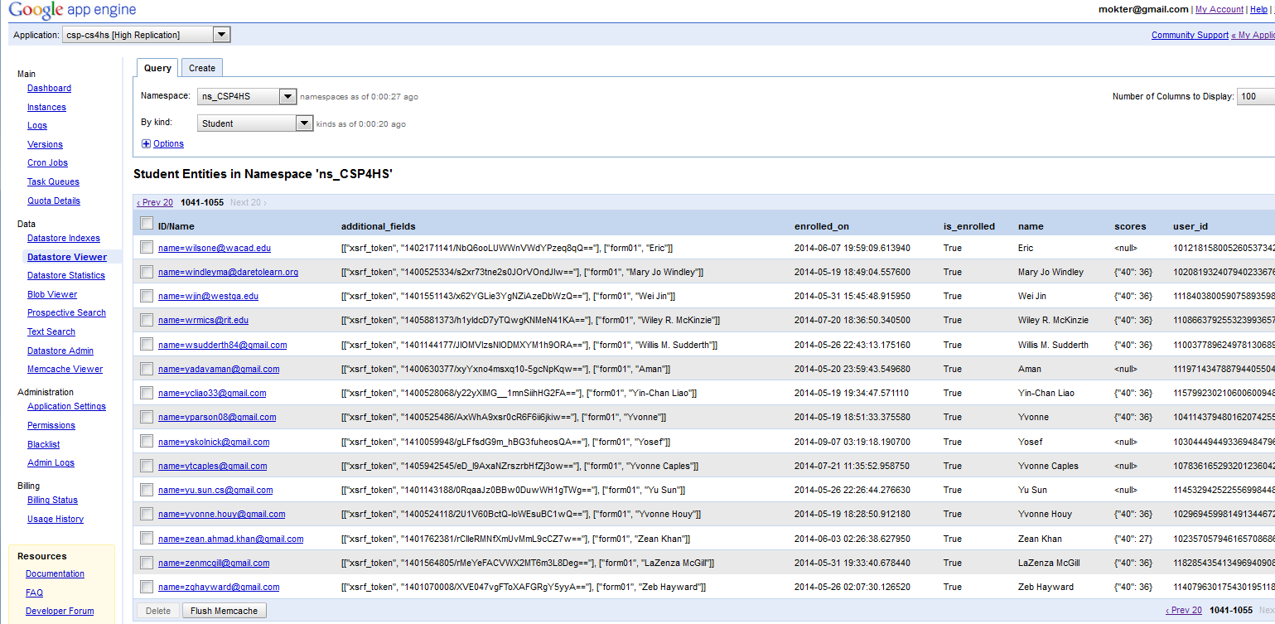
Implementation of a MOOC with Google Course Builder and App Engine
Google App Engine Datastore Viewer

Slide 16
Implementation of a MOOC with Google Course Builder and App Engine
Downloading Course Data from Google App Engine
The hardest part of the entire process!!
Resources:
https://code.google.com/p/course-builder/
https://cloud.google.com/appengine/docs

Slide 17


Implementation of a MOOC with Google Course Builder and App Engine
Thank You

